Slide 1

Entity Framework Core 5

Slide 2
Building your first ef Core

Slide 3
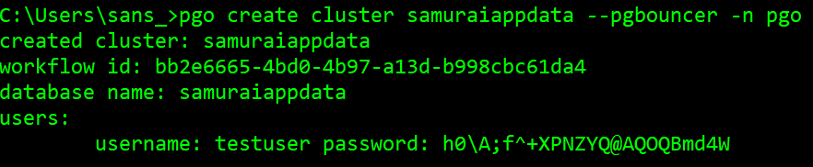
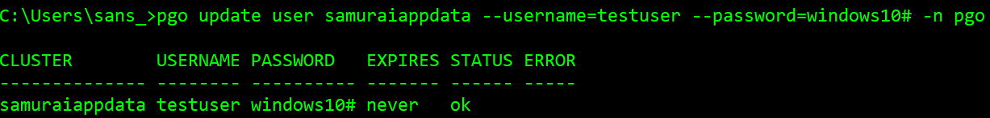
Create a database cluster in PostgreSQL

Slide 4
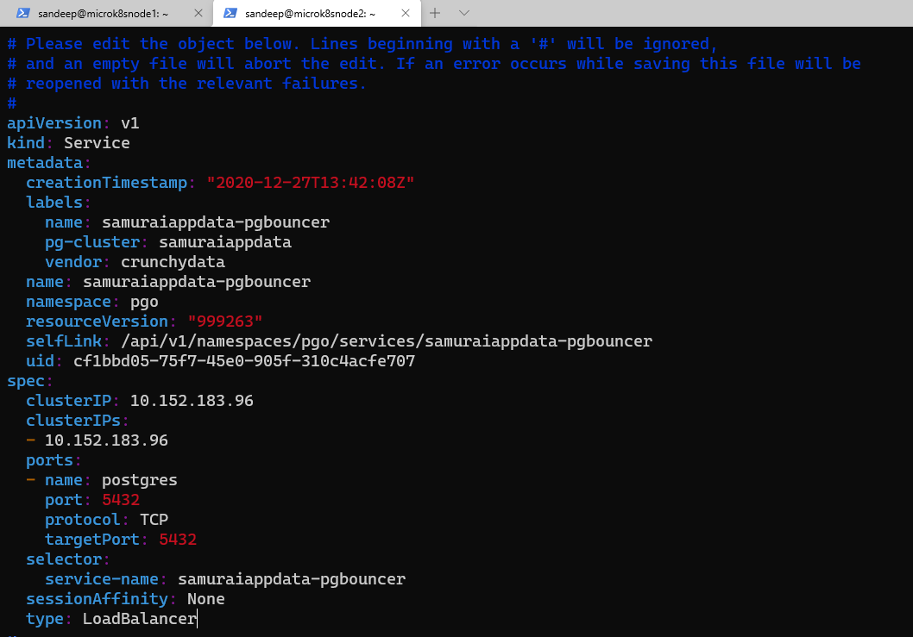
Change the samuraiappdata-pgbouncer service

Slide 5
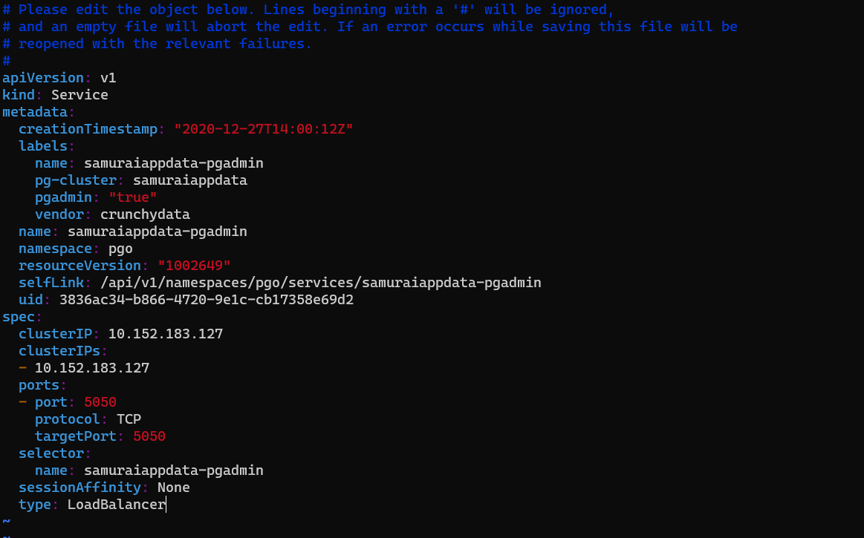
Change the samuraiappdata-PGADMIN service

Slide 6
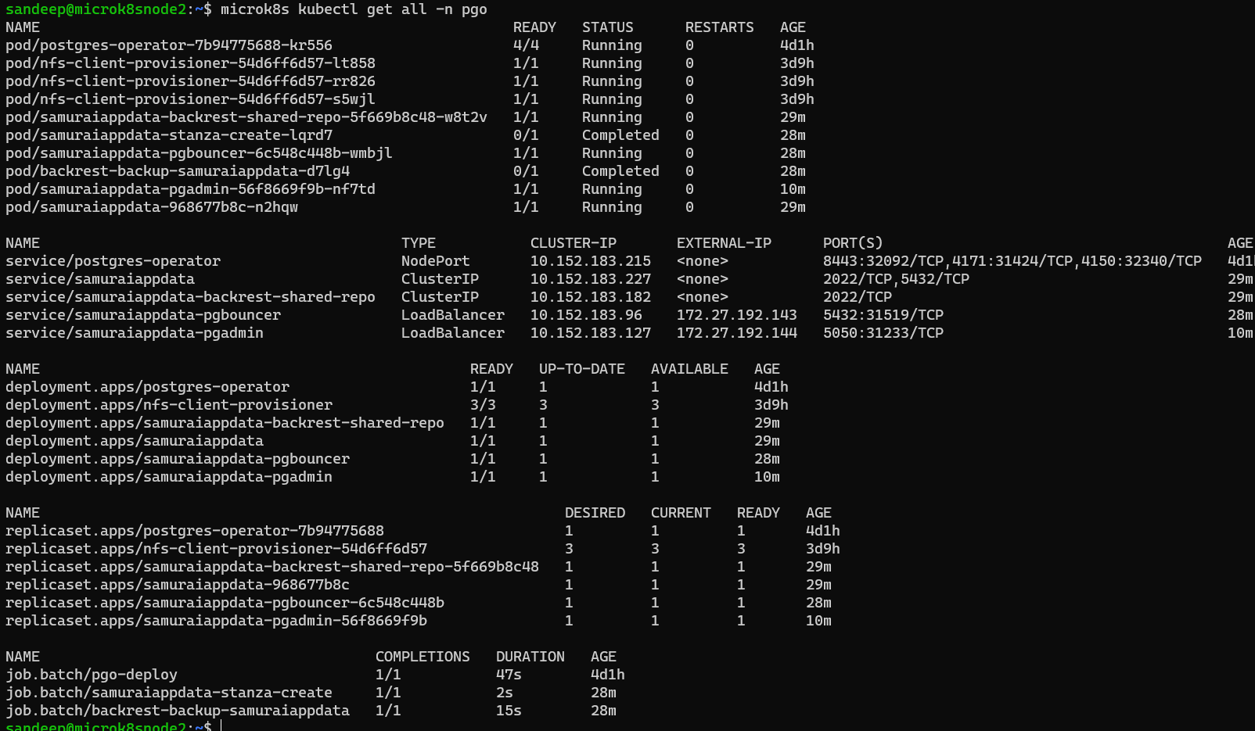
Inspect samruraiappdata services

Slide 7
Controlling database creation and scheme

Slide 8
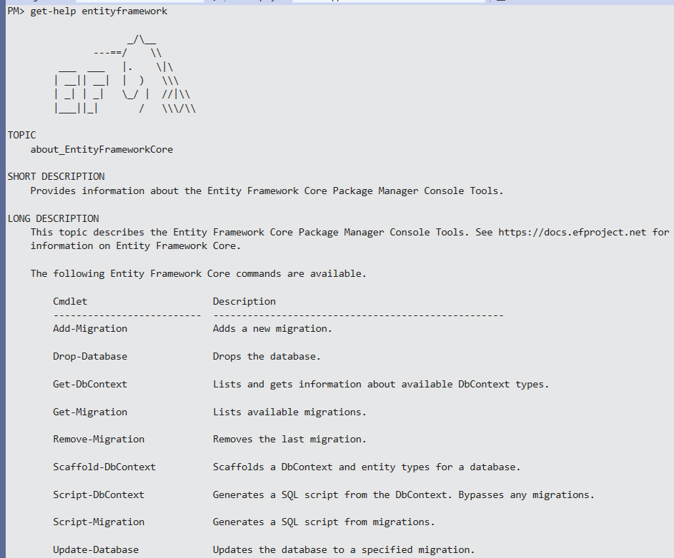
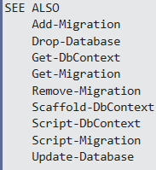
Entity FRAMEWORK (Get-Migration is new to ef core 5)

Slide 9
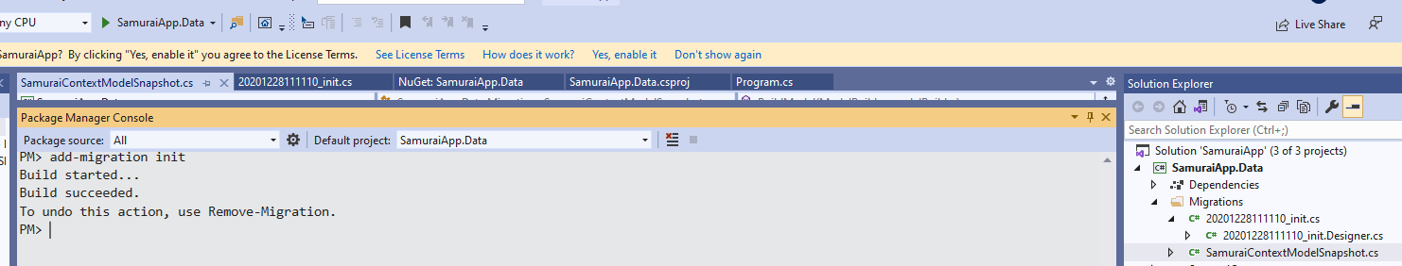
Add Migration
Data library project (SamuraiApp.Data) targets .NET 5, so is able to run migrations, unlike earlier libraries targeting .NET5
standard.
The snapshot is used to determine how to migrate from one model version to the next.

Slide 10
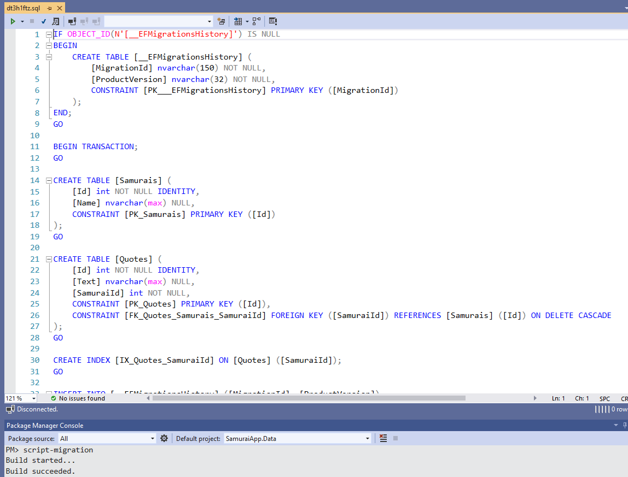
Script-migration

Slide 11
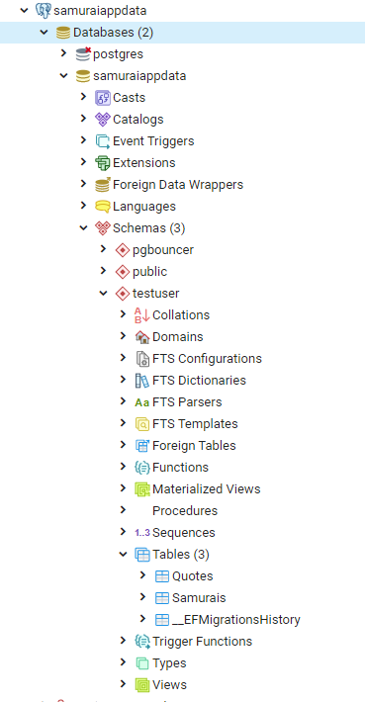
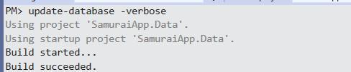
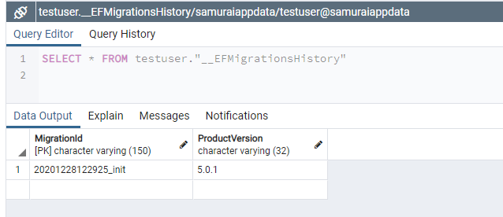
Update database

Slide 12
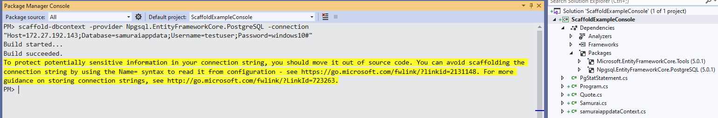
Reverse engineer an existing database
EF Core 5 scaffolding now defaults to creating singular names for the entity classes.
SQL Server
PostgreSQL

Slide 13
Links
https://docs.microsoft.com/en-us/ef/core/managing-schemas/migrations/teams
https://cmatskas.com/ef-core-migrations-with-existing-database-schema-and-data/

